Slide 1

Insurance Analytics Project : P864 GROUP - 6

Slide 2

Meet Our Team
Bhagyashree Kar
Rakshitha R P
Manasi Shashikant Chavan
Akash Subhash Narwade
Yempalle Pojja Shivraj

Slide 3




Domain : Insurance Analytics Modules :
MS Excel
Power Bi
MySQL
Tableau

Slide 4
Agenda
Project Goal & Insurance Analytics
Introduction
Dataset Description
Data Schema
KPI Analysis
Dashboard Design
Recommendation
Conclusion

Slide 5

Introduction
This presentation overviews the Insurance Branch Analytics Dashboard, focusing on key performance indicators (KPIs) for new business and renewal performance. The dashboard provides actionable insights to optimize branch operations and achieve strategic goals.

Slide 6

Project Goal
Branch dashboard to discuss New and renewal business number with each branch. This dashboard will be discussed between Corporate team and Individual branch heads.
Discuss performance metrics in the branch.
Overall performance summary
Detailed branch performance
Key insights and action items
Summary of new ,cross sell and renewal business numbers for the branch

Slide 7
Dataset Description
Brokerage -> Contain information about clients' policies, including policy details, income, and renewal status.
Fees -> Contains data on client-related income transactions, including revenue details and transaction types.
Budget -> Details the budget allocations for branches and employees, including new roles, cross-sell initiatives, and renewals.
Invoice -> Holds information about invoices generated, including transaction details and associated clients.
Meeting -> Tracks meetings managed by account executives, including branch associations and attendee details.
Opportunity -> Documents details of opportunities managed by account executives, including revenue, stages, and risk information

Slide 8

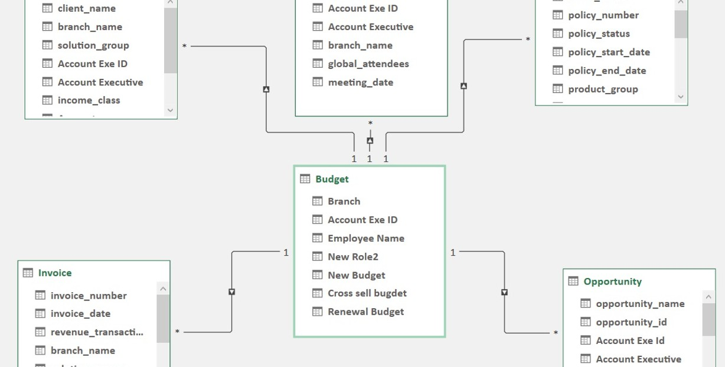
Data Schema

Slide 9
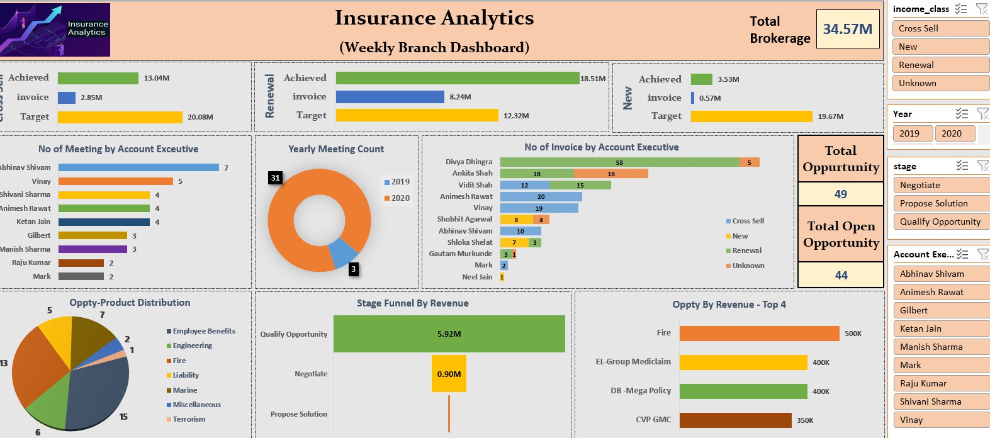
Excel Dashboard

Slide 10
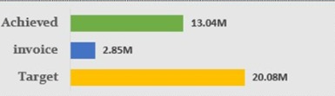
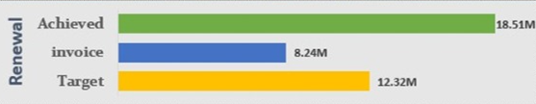
Key Performance Indicators (KPIs)
The image shows a horizontal bar chart comparing three main performance metrics:
Target (Yellow Bar)
Value: 20.08M
This is the goal or expected total outcome. It represents 100% of what needs to be achieved.
Achieved (Green Bar)
Value: 13.04M
This indicates how much has been successfully accomplished so far toward the target.
It's about 64.94% of the target.
Invoice (Blue Bar)
Value: 2.85M
This shows the amount that has been billed or invoiced up to this point.
It's about 14.19% of the target.
This image is a KPI (Key Performance Indicator) chart related to Renewal performance, displaying three metrics:
Achieved (Green Bar):
Value: 18.51M
This shows the total value of renewals that have been successfully achieved.
It exceeds the target, indicating strong performance.
Invoice (Blue Bar):
Value: 8.24M
This is the amount that has actually been invoiced so far.
It is below both the achieved amount and the target, possibly indicating delays in billing or pending invoices.
Target (Yellow Bar):
Value: 12.32M
This is the goal or expected value for renewals.
It serves as a benchmark to assess performance.

Slide 11
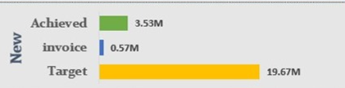
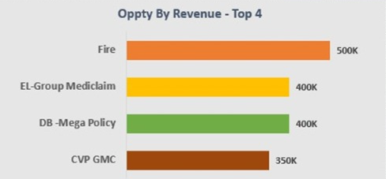
KPI Category: New
Achieved (Green Bar)
Value: 3.53M
This is the amount of new business secured so far.
It is significantly below the target.
Invoice (Blue Bar)
Value: 0.57M
This is the value of new business that has actually been invoiced.
It is much lower than both the achieved value and the target.
Target (Yellow Bar)
Value: 19.67M
This is the goal for new business acquisition.
Fire – Generates the highest revenue among the four at 500K.
Represented with an orange bar.
EL-Group Mediclaim – Brings in 400K in revenue.
Represented with a yellow bar.
DB - Mega Policy – Also brings in 400K in revenue.
Represented with a green bar.
CVP GMC – Generates 350K in revenue.
Represented with a brown bar.
Interpretation:
The chart compares these four categories based on revenue contribution.
Fire is the top performer.
EL-Group Mediclaim and DB - Mega Policy are tied for second place.
CVP GMC is in fourth place.

Slide 12
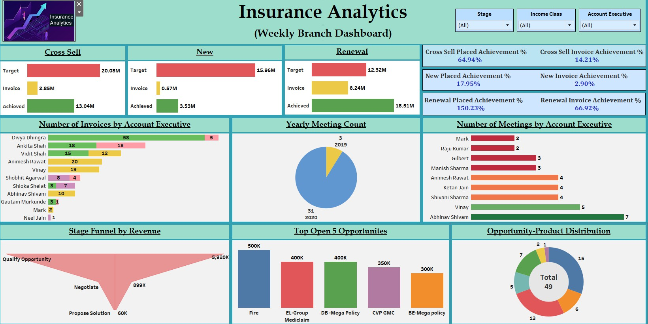
Tableau Dashboard

Slide 13
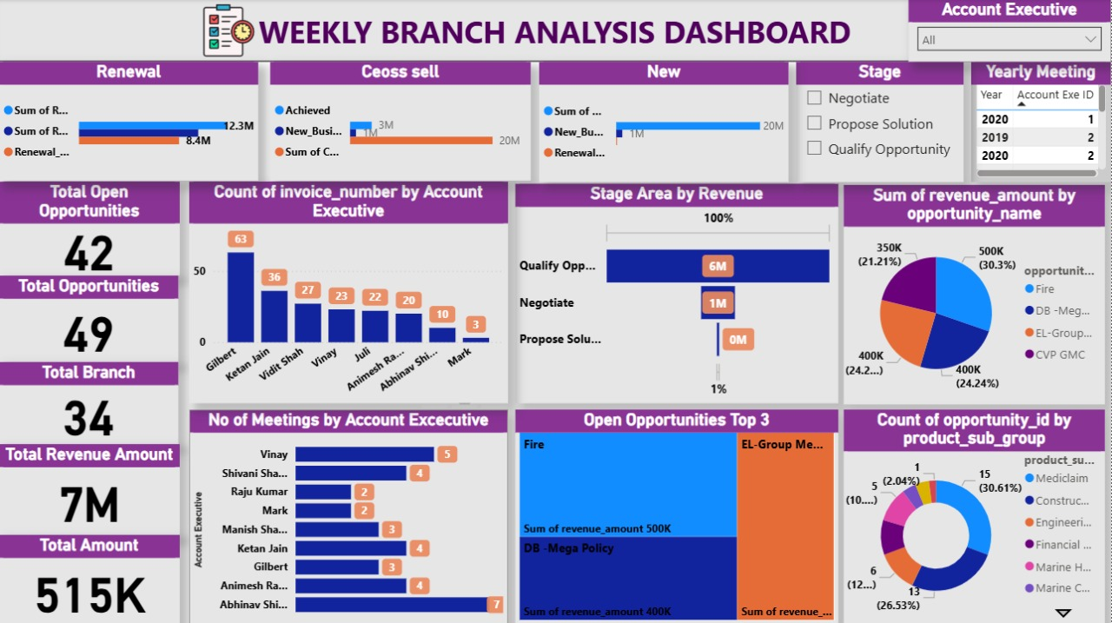
Power Bi Dashboard

Slide 14
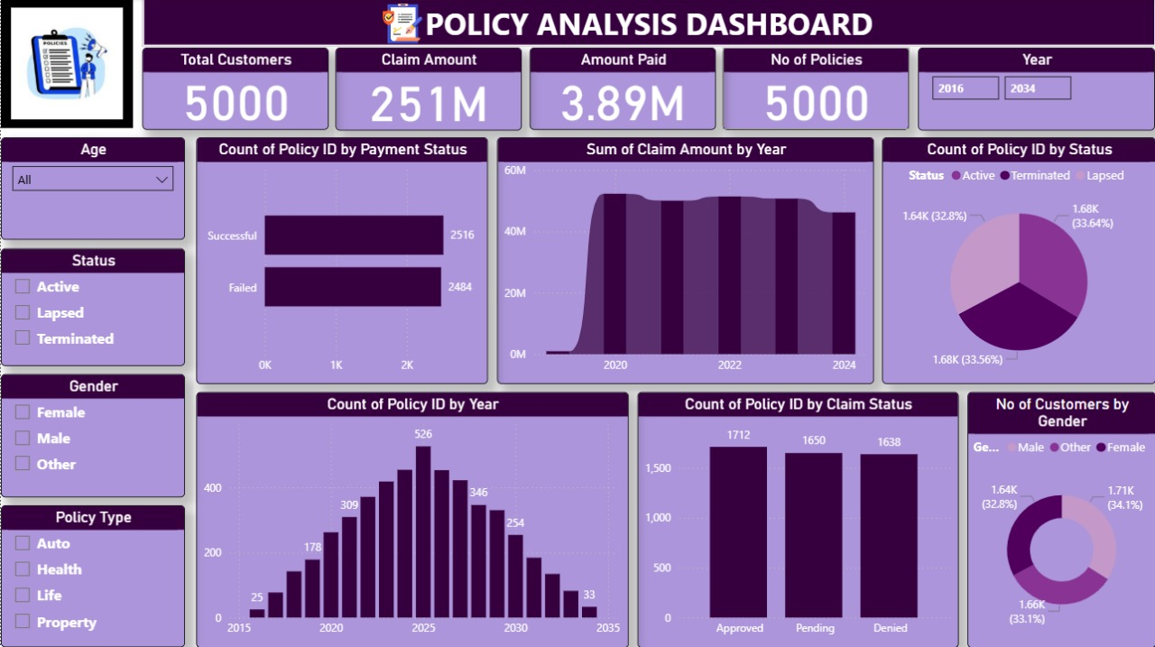

Slide 15
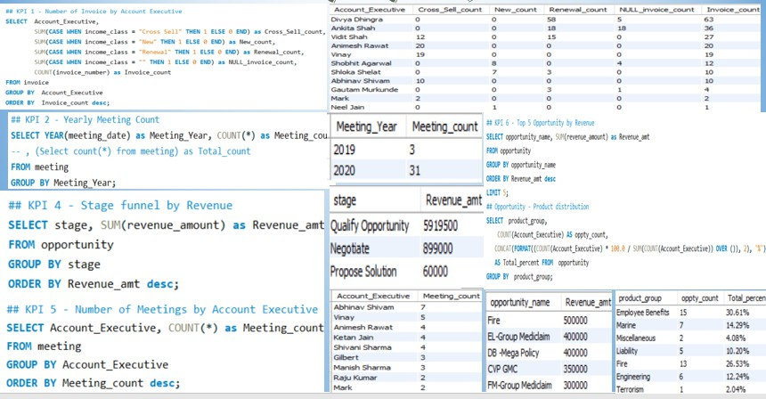
MySQL Queries

Slide 16
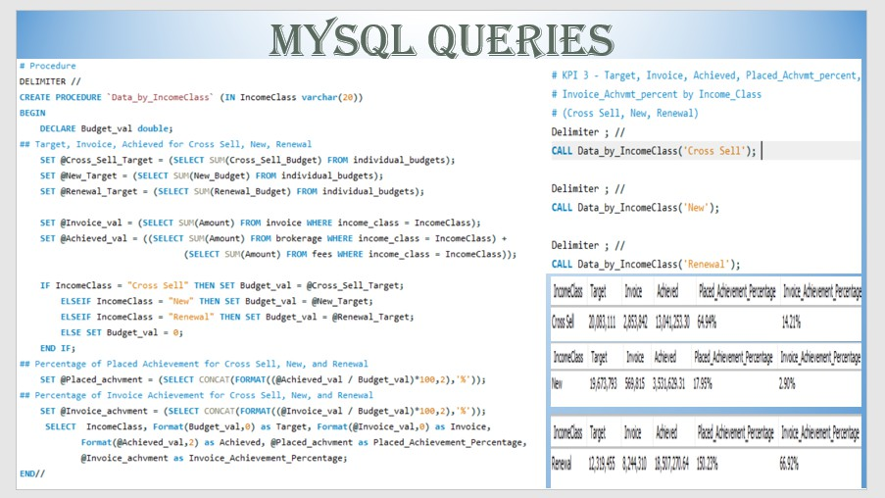
MySQL Queries

Slide 17
Conclusion
NEW PERFORMANCE
Steady growth with a decent profit margin. Need to focus on increasing the growth rate
Total: 19.674 M
Profit: 0.5698 M
Revenue: 3.5316 M
Profit Margin: 17.95%
Growth Rate: 2.90% CROSS-SELL PERFORMANCE
High profitability and significant growth. Continue leveraging cross-selling opportunities.
Total: 20.083 M
Profit: 2.854 M
Revenue: 13.04 M
Profit Margin: 64.94%
Growth Rate: 14.21%

Slide 18

RENEWAL PERFORMANCE
Exceptional performance in renewals with very high profit ability and growth. Maintain this strong focus
Total: 12.32 M
Profit: 8.244 M
Revenue: 18.507 M
Profit Margin: 150.23%
Growth Rate: 66.92%

Slide 19
Recommendation
Enhance Customer Service
Implement AI-driven chatbots for 24/7 customer support.
Train staff on customer engagement and conflict
resolution.
Expand Product Offerings
Introduce new insurance products tailored to emerging markets.
Bundle products for better value to customers
Increase Sales and Retention
Launch personalized marketing campaigns based on customer data.
Introduce loyalty programs to reward long-term
customers.
Market Analysis and Adaptation
Conduct market research to identify customer needs and preferences.
Adjust strategies based on competitive analysis
and market trends.
Employee Engagement
Foster a positive work environment to boost employee morale.
Introduce employee recognition programs to
retain top talent.
Enhance Operational Efficiency
Conduct regular training sessions for employees on new technologies.
Team collaboration activities

Slide 20


